Slide 1
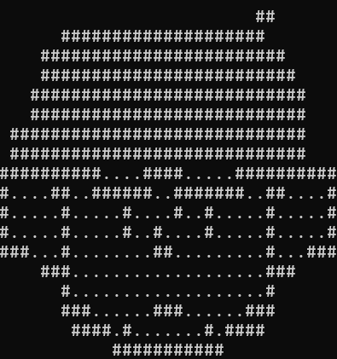
WIU Group 6
“REPLICATION”
JUNSHEN
Kayden - Ahmad - Shi Ze - Junshen - Yu Heng
Notes:
JUNSHEN

Slide 2
High Concept
JUNSHEN
“Replication” is a Sci-Fi 2D Turn-Based RPG where you are a rogue clone fighting your way through mutants and guards with the help of unlockable abilities and items to escape a facility owned by a shady corporation.
Notes:
YU HENG

Slide 3
Story
SHI ZE
Pedro, the main protagonist, is a soldier fatally wounded in combat who is selected for a new generation of super soldiers. However, the enhancement process turns him amnesiac.
Sometime later, the facility goes into lockdown, giving Pedro the chance to escape. He fights his way through mutants and guards, until he meets the head of security, Nikolai Warden.
After a final battle, Pedro emerges victorious and escapes the facility.
Notes:
SHIZE

Slide 4
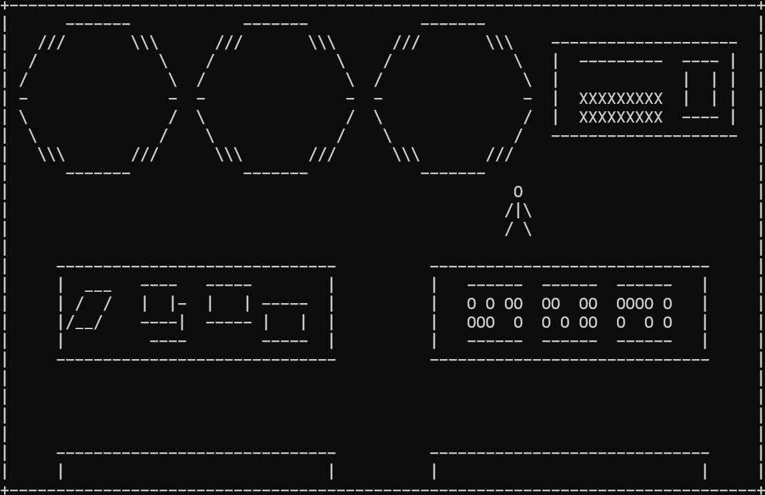
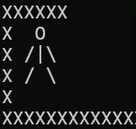

Features
(World)
KAYDEN
2D Top-Down World Exploration
Original Dark Sci-Fi Soundtrack
In-depth storytelling
Collisions
Dialogue system for interactive props
Notes:
KAYDEN

Slide 5
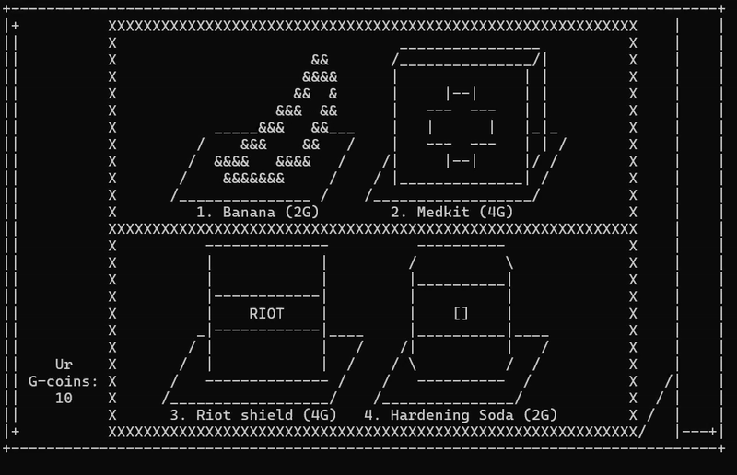
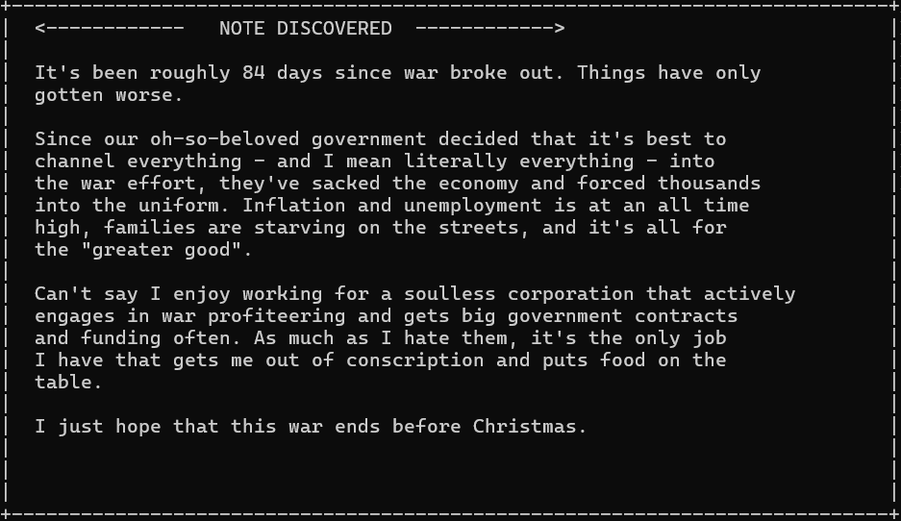
Features
(World)
KAYDEN
Vending Machines to buy items
+ “GCoin” system as currency
Discoverable notes for lore and world-building
Notes:
KAYDEN

Slide 6
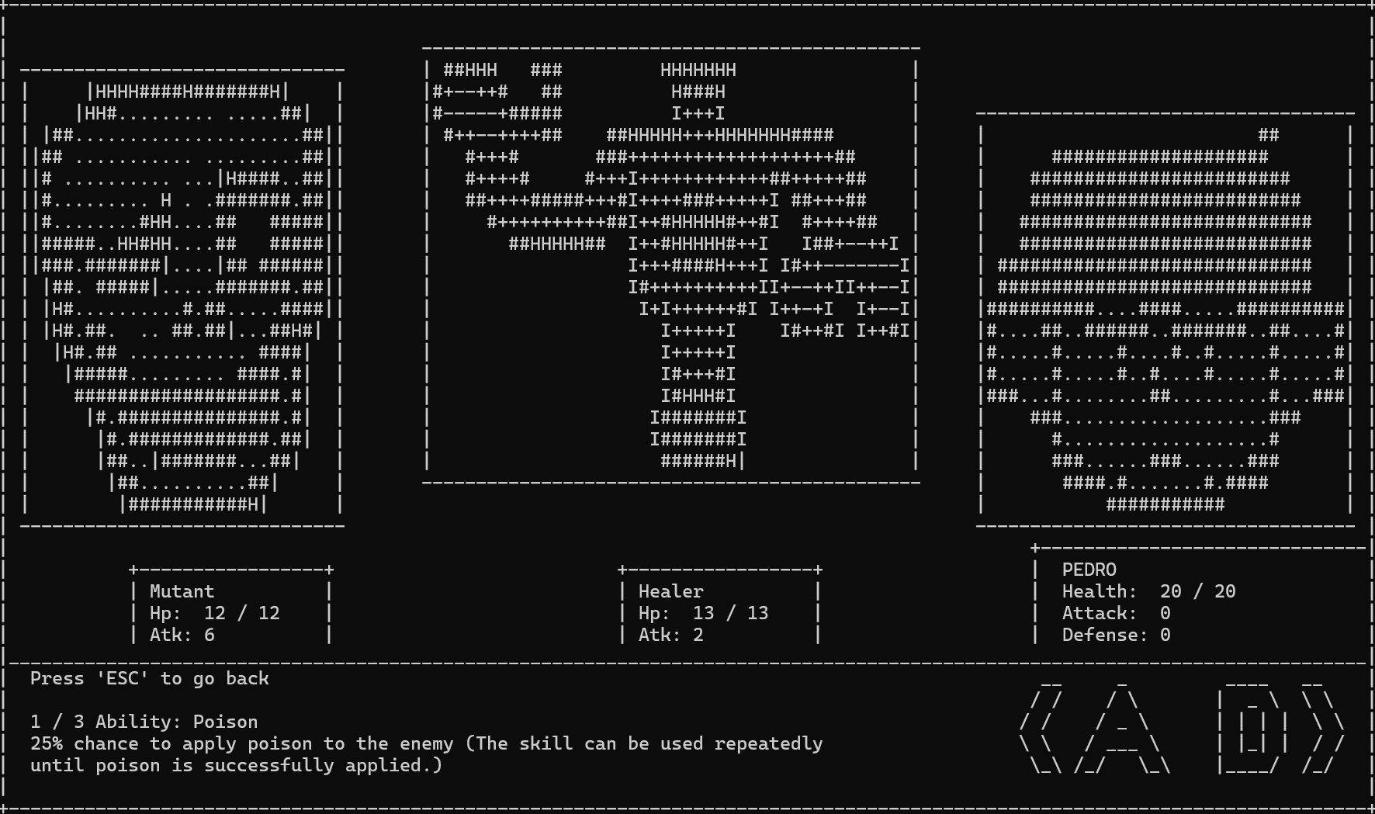
Features
(Battle)
AHMAD
Turn-Based Battle System
Can have one or two enemies per battle
Each of the 4 enemies have unique abilities (if player defeats said enemy, they unlock their ability and can use it for future battles)
Poison
Recover
Armour
Sound Effects
ATTACK enemies to lower health
Player gains GCoins if they win the battle
You can FLEE the battle if you are ill-prepared
Notes:
AHMAD

Slide 7
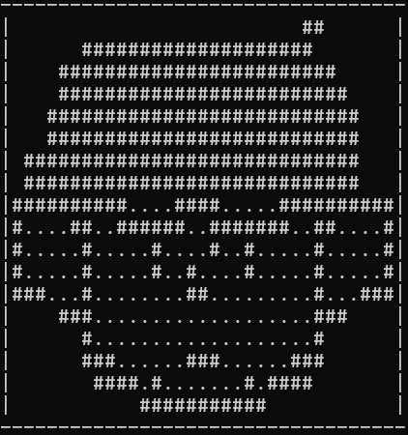
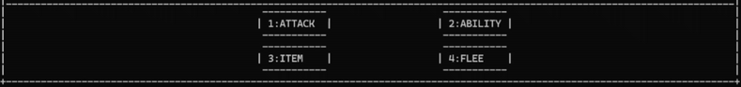
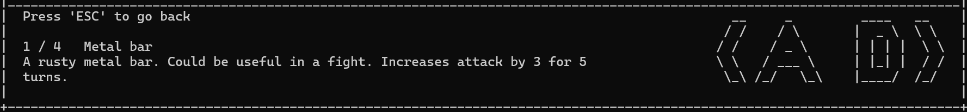
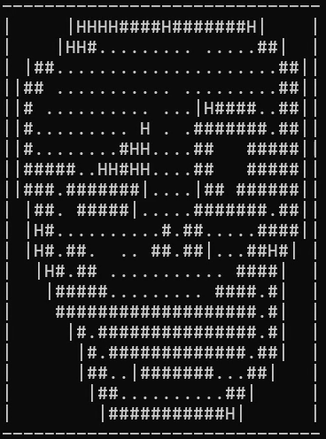

Features
(Battle)
AHMAD
Sprite animations during battle
(Player)
Battle commentary console
Use ITEMS to boost health, attack, defence in battle
(Enemy)
Unlockable Abilities during battle
Notes:
AHMAD

Slide 8
Roles and Responsibilities
AHMAD
Kayden
Ahmad
Yu Heng
Shi Ze
Jun Shen
Main programmer
Project Manager
Music Designer
World Systems Programmer
Secondary Programmer
Battle Systems Programmer
Bug Fixer
Economy and Statistics Programmer
Mechanics Writer
Map Designer
Puzzle Designer
Story Writer
Map Designer
Vending Machine
Logic
Visual Artist
Main Animator
Intro Designer
SFX Designer
Notes:
AHMAD

Slide 9
Kayden
Player interactions with map objects
Collision with props and walls
Dialogue system
Dialogue box appears at the bottom of the world
Music Production
5 Original Soundtracks
Map Editor Framework Designer
Prop System, Map System
Notes:
KAYDEN

Slide 10
Ahmad
Battle System
Player and Enemy attacks
Battle UI
UI to display stats and buttons
Items
Items to be used in battle
Abilities
3 abilities
Notes:
AHMAD

Slide 11
Jun Shen
Title Screen
Coded the title screen animations and logic
Sprite Design
Designed the sprites for the enemies and the player
Animations
Used the battle animator system to program enemy and player animations
Audio
Coded the main AudioHandler class
Notes:
Junshen

Slide 12
Shi Ze
Map Design (Second half)
Used Level Designer to lay out map and dialogue interactions
Vending Machine
Coded the UI and logic for Vending Machines
Collectibles
Programmed where the collectibles would be
Notes
Programmed and wrote the notes and placed them inside the levels
Notes:
SHI ZE

Slide 13
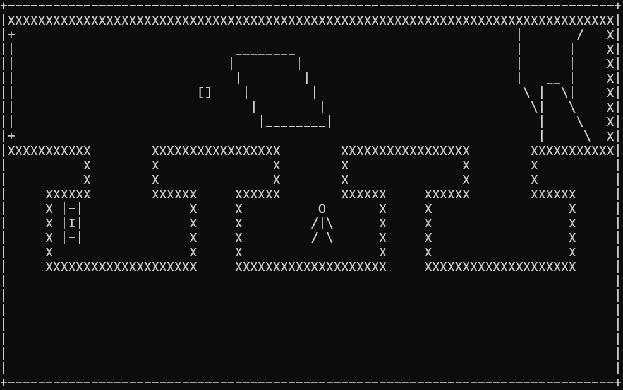
Yu Heng
Map Design (First half)
Used Level Designer to lay out map and dialogue interactions
Battle Layout
Coded which enemies would appear and where they would be
Statistics
Defined statistics and coded classes for player statistics
Economy
Coded the GCoins system
Notes:
YU HENG

Slide 14
Thank you
YU HENG
Template created by Slidesgo
Notes:
YU HENG

